Slide 1
Image Sharpening
Image sharpening is a crucial process in digital image processing, aimed at improving the clarity and crispness of visual content.
By emphasizing the edges and fine details in a picture, sharpening transforms dull or blurred images into visuals where objects stand out more distinctly from their backgrounds.
This not only makes photographs more visually appealing but also enhances their usefulness in analysis, recognition and interpretation tasks.

Slide 2
Image Sharpening
Sharpening Filters are based on the first and second order derivatives.
The derivatives of a digital function are defined in terms of differences.
Common Techniques
Laplacian Filter
Unsharp Masking (USM)
High Boost Filtering

Slide 3
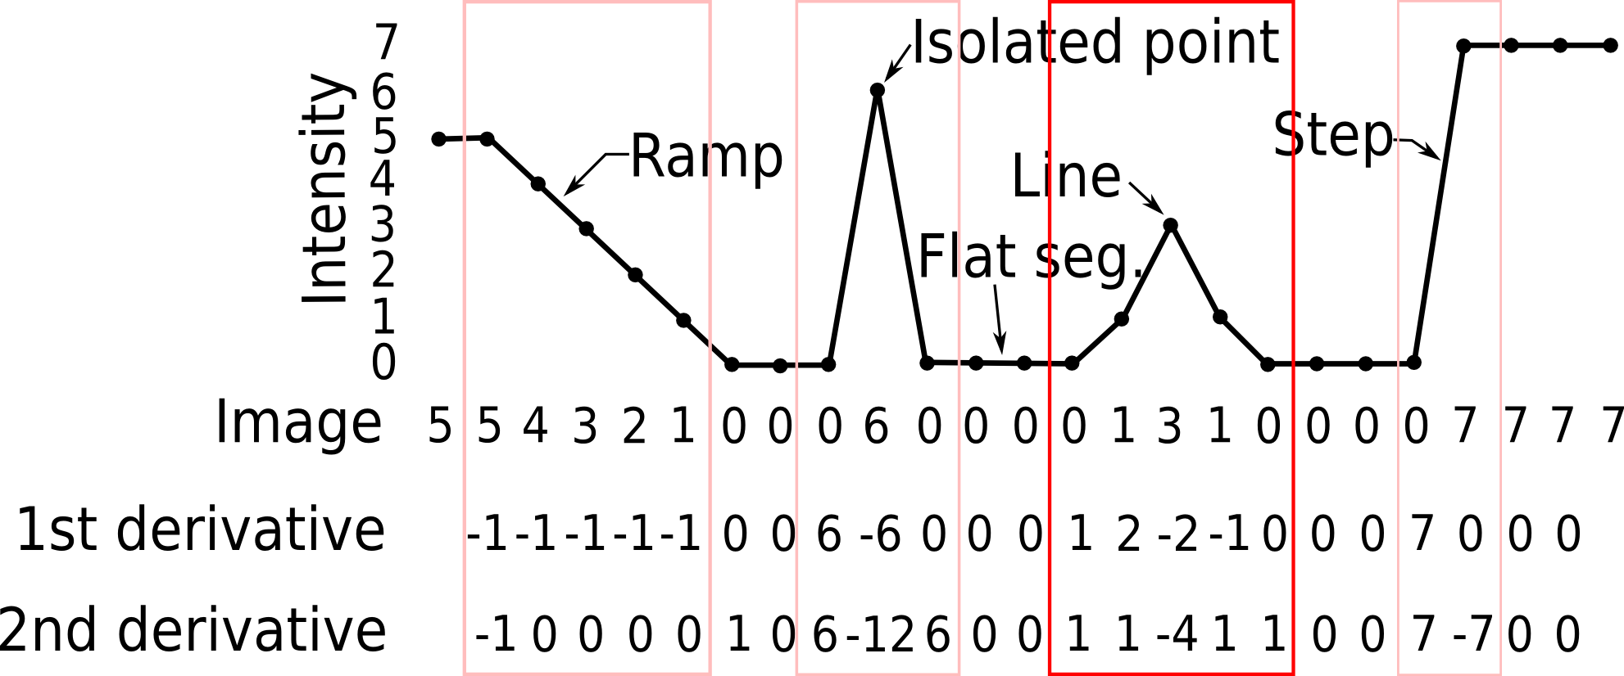

Slide 4
We require that any definition we use for a first derivative:
Must be zero in areas of constant intensity.
Must be nonzero at the onset of an intensity step or ramp.
Must be nonzero along intensity ramps.
Similarly, any definition of a second derivative
Must be zero in areas of constant intensity.
Must be nonzero at the onset and end of an intensity step or ramp.
Must be zero along intensity ramps.

Slide 5
Edges in digital images often are ramp-like transitions in intensity, in which case the first derivative of the image would result in thick edges because the derivative is nonzero along a ramp.
On the other hand, the second derivative would produce a double edge one pixel thick, separated by zeros.
From this, we conclude that the second derivative enhances fine detail much better than the first derivative, a property ideally suited for sharpening images.
Also, second derivatives require fewer operations to implement than first derivatives, so our initial attention is on the former.

Slide 6
Image Sharpening
Laplacian Filter:
It highlights gray level discontinuities in an image.
It deemphasizes regions with slowly varying gray levels
It computes the second-order derivative of an image to detect edges. We need a Laplacian filter so that we can extract the features of the image in a better way.

Slide 7
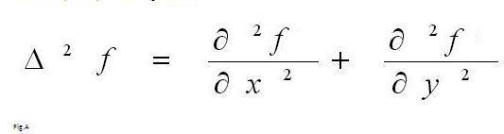
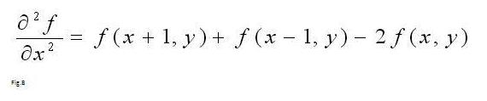
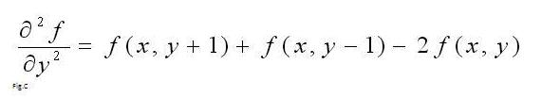
Sharpening
Formula for 2D:
For X-direction
For Y-direction

Slide 8
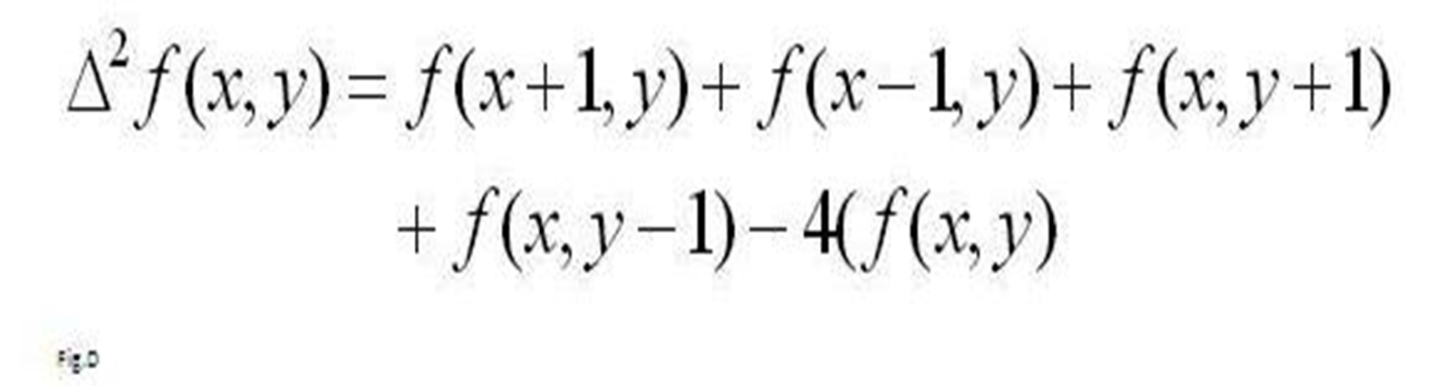
By substituting 2 and 3 to 1 we get

Slide 9
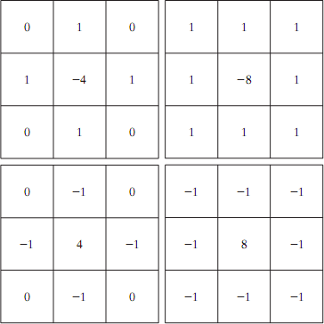
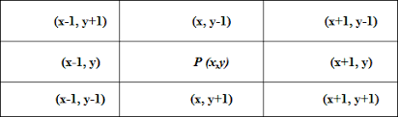
Filter masks

Slide 10
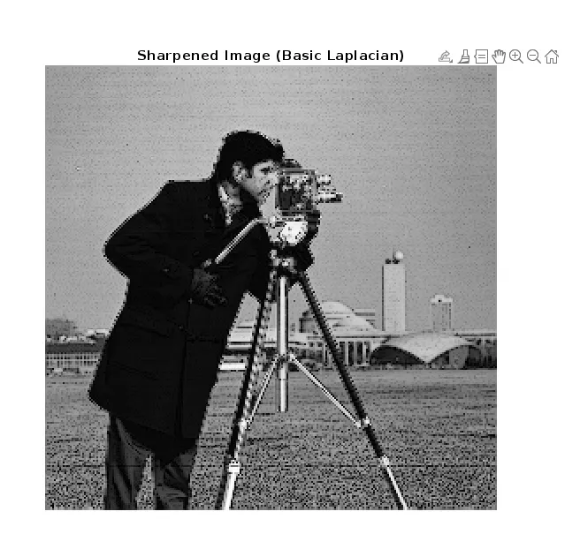
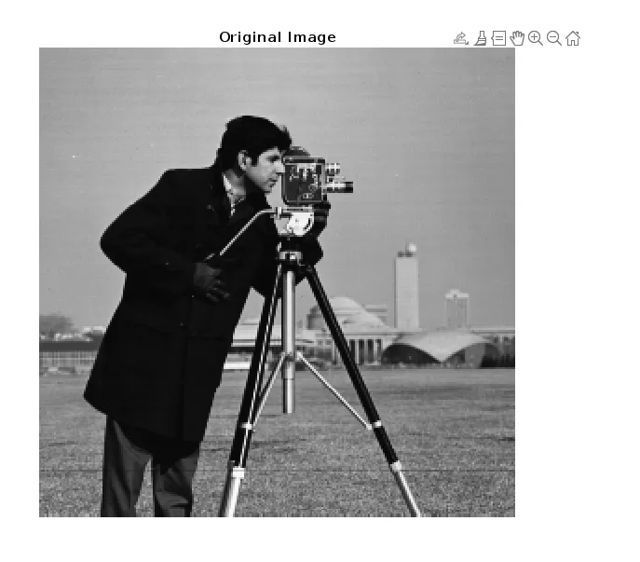

Slide 11
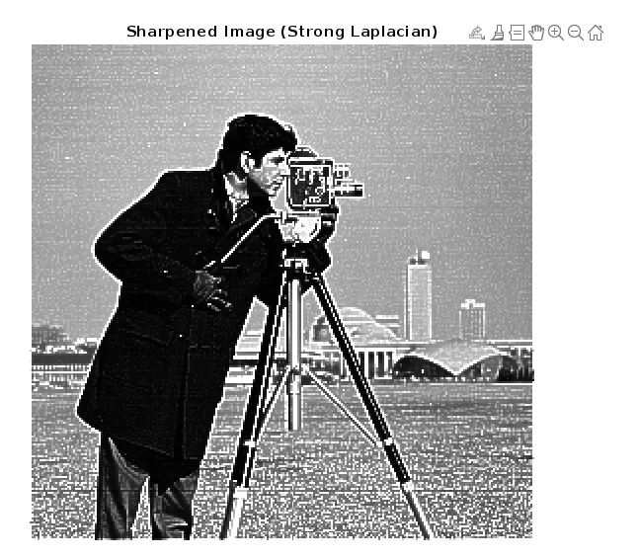

Slide 12
Image Sharpening
Unsharp Masking (USM)
A popular method where a blurred version (the "unsharp mask") of the image is subtracted from the original.
Primarily used in the printing and publishing industry to sharpen images.

Slide 13
Steps in Unsharp Masking:
Blur the Image: Apply a low-pass filter (like a Gaussian filter, 𝑔(𝑥,𝑦) to the original 𝑓(𝑥,𝑦) to create a blurred version, 𝑓_{𝑏}(𝑥,𝑦).
Create the Mask: Subtract the blurred image from the original:
𝑀𝑎𝑠𝑘(𝑥,𝑦)=𝑓(𝑥,𝑦)−𝑓_{𝑏}(𝑥,𝑦).
This mask contains only the high-frequency details (edges).

Slide 14
Sharpen the Image: Add a scaled version of the mask back to the original image:
𝐺(𝑥,𝑦)=𝑓(𝑥,𝑦)+A⋅𝑀𝑎𝑠𝑘(𝑥,𝑦).
  𝑘(Amount/Strength): Controls the intensity of sharpening
  (e.g., 𝑘=1 for standard unsharp masking,
  𝑘>1 for high boost filtering).

Slide 15
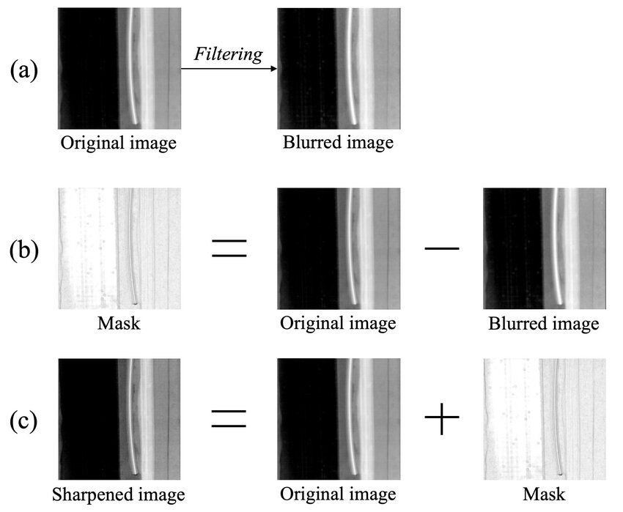

Slide 16
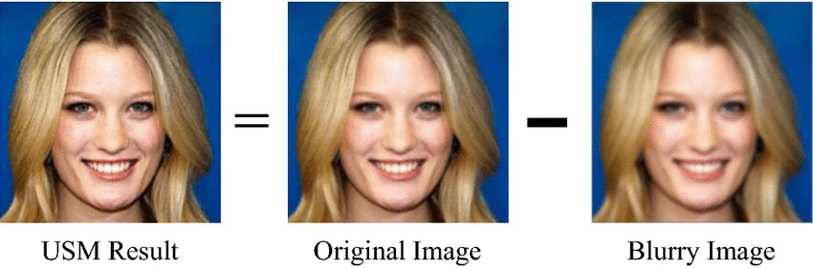

Slide 17
Highboost Filtering
It acts as a generalized version of unsharp masking, using a boosting factor
𝐴≥1 to control the intensity of the sharpening.

Slide 18
When A=1, it becomes regular high-pass filtering (or unsharp masking); when A>1, it's high-boost filtering.

Slide 19
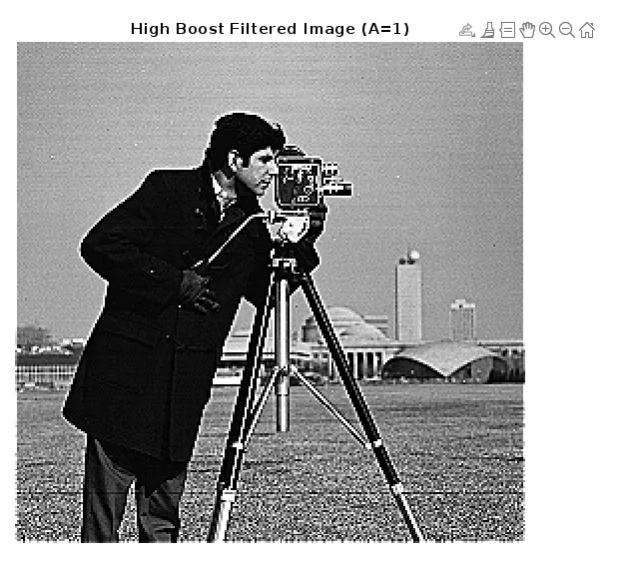

Slide 20

Original image of size 600 259 × pixels.
Image blurred using Gaussian lowpass.
Mask.
Result of unsharp masking A = 1.
Result of highboost filtering with A = 4 5.

